Slide 1

AI Tools and Platforms: Overview, Applications, and Business Integration
AI4Business

Slide 2
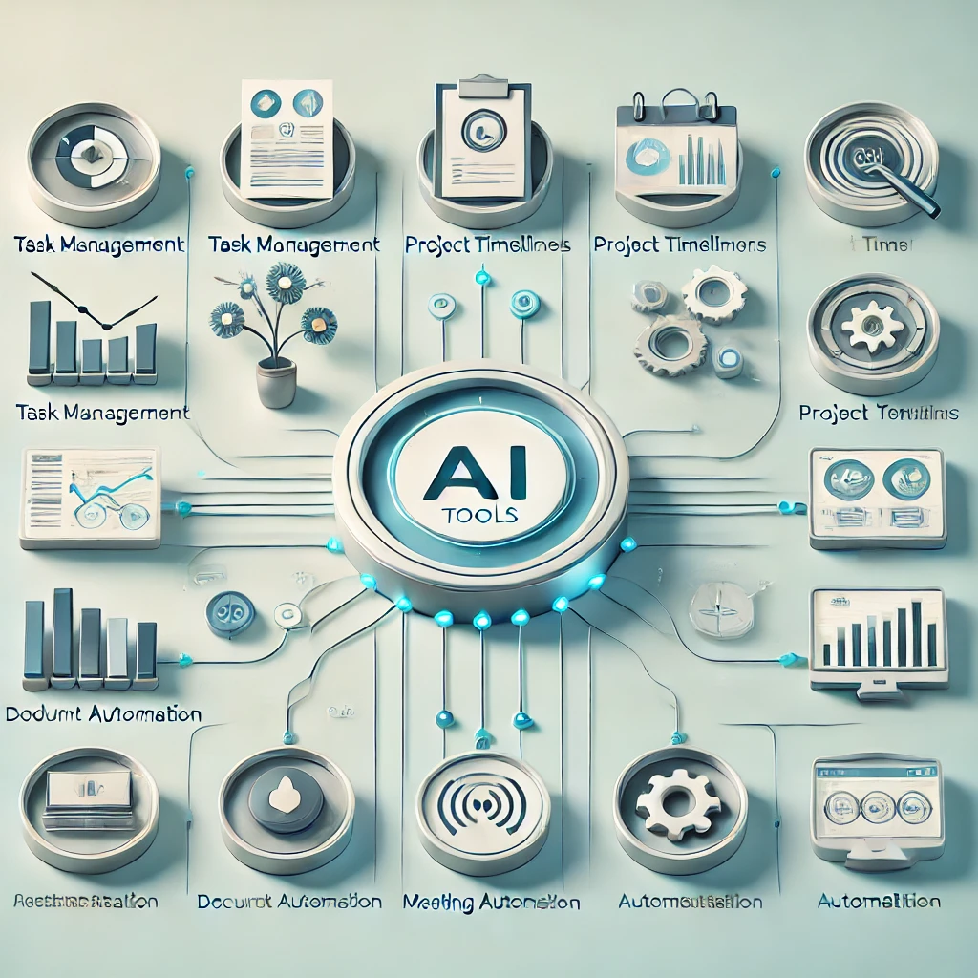
Introduction
What are AI tools and platforms?
AI tools are software applications that leverage machine learning, deep learning, and automation techniques to perform tasks traditionally requiring human intelligence.
Types of AI tools: Business intelligence software, automation tools, predictive analytics platforms, AI-powered customer relationship management (CRM) systems.

Slide 3

Introduction
Importance of AI in business decision-making:
Data-driven insights: AI helps businesses analyze vast amounts of data for better decision-making.
Automation: AI streamlines repetitive tasks, improving efficiency and reducing costs.
Competitive advantage: Companies adopting AI can optimize operations, enhance customer experiences, and drive innovation.
Risk mitigation: AI-powered fraud detection and cybersecurity tools help prevent financial and security risks.

Slide 4
Introduction
Overview of the lecture structure:
Introduction to AI tools and platforms.
Deep learning frameworks and AI applications in different business sectors.
AI tools for content creation, social media, and marketing.
Business intelligence, predictive analytics, and automation.
Case studies on real-world AI applications.
Ethical concerns and future trends in AI.

Slide 5
Introduction
AI can automate tasks like learning, reasoning, problem-solving, decision-making, and natural language processing.
Examples of AI software include chatbots, virtual assistants, recommendation engines, and image/speech recognition software.
Most AI software uses data analysis to make decisions and recommendations.
This lecture will overview the best artificial intelligence software offerings around today.
To perform specific tasks, AI software need to integrate with other systems and apps, such as databases, cloud platforms, or IoT devices, which require robust integration tools for smooth communication and data transfer between the systems

Slide 6
Deep Learning Frameworks
These frameworks provide a high-level interface that simplifies the process of:
Designing the architecture of your neural network (think of it as the blueprint)
Training the network on large datasets to learn and improve its performance
Validating the performance of the trained network

Slide 7
Deep Learning Frameworks
What deep learning frameworks offer:
Building Blocks: Frameworks provide pre-written code for common neural network layers and functions, saving you time and effort.
Automatic Differentiation: They handle the complex math behind calculating gradients, which is essential for training neural networks.
Optimization Algorithms: Frameworks come with built-in optimization algorithms that efficiently adjust the network's parameters during training.
Hardware Acceleration: They leverage powerful hardware like GPUs (Graphics Processing Units) to speed up training times significantly.
Flexibility: Many frameworks allow you to define custom layers and functions, giving you control over the inner workings of your model.

Slide 8
AI Development Frameworks
Key Functions:
Designing Neural Networks: Frameworks enable the creation of neural network architectures, such as convolutional neural networks (CNNs) for image processing or recurrent neural networks (RNNs) for sequence data.
Training and Optimizing Models: These tools streamline the training process, allowing data scientists to build and fine-tune AI models efficiently through backpropagation and gradient descent.
Hardware Acceleration (GPUs): To handle large datasets and complex computations, frameworks often integrate with graphical processing units (GPUs) to speed up model training.
Definition: AI development frameworks, also known as deep learning frameworks, are software libraries that facilitate the creation, training, and optimization of machine learning and deep learning models. These toolkits provide a set of functions, pre-built algorithms, and utilities that simplify the process of AI development.

Slide 9
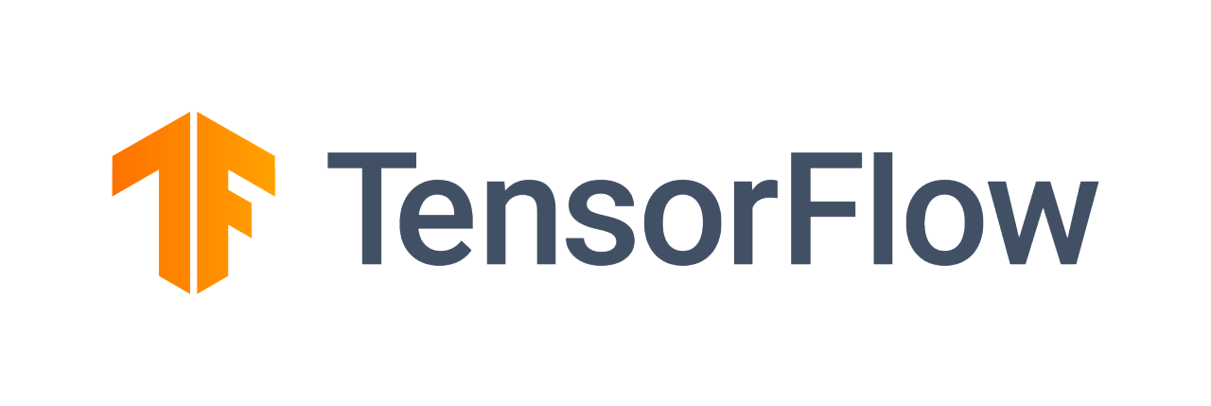


AI Development Frameworks
Examples of Popular Frameworks:
TensorFlow: An open-source framework developed by Google, TensorFlow is highly flexible and widely used in both research and production. It supports a range of deep learning applications from image recognition to natural language processing.
PyTorch: Developed by Facebook, PyTorch offers dynamic computation graphs, making it especially popular in academic and research environments due to its ease of use and flexibility.
Keras: Originally an independent framework, Keras is now integrated into TensorFlow and provides a high-level interface for building neural networks. It simplifies model creation by offering an intuitive API.

Slide 10
AI Applications in Business - Examples
Marketing & Sales:
AI can automate content generation for advertising, enhancing productivity and reducing costs.
Personalization algorithms analyze consumer data to tailor product recommendations, advertisements, and promotions based on individual preferences.
Finance:
AI-driven platforms help predict stock market trends by analyzing vast amounts of data in real-time, providing insights that assist in trading decisions.
Fraud detection systems utilize machine learning to identify unusual patterns in financial transactions, protecting businesses and consumers from financial crimes.
Healthcare:
Diagnostic AI tools can analyze medical images, such as X-rays and MRIs, to detect diseases and abnormalities faster and more accurately than human clinicians.
In drug discovery, AI models analyze complex biological data to identify potential compounds for new medicines, speeding up the research and development process.
AI AI Tools Across Industries: AI tools are becoming integral in a variety of industries, driving innovation, efficiency, and accuracy. From marketing and finance to healthcare and manufacturing, AI is transforming the way businesses operate and interact with customers.

Slide 11
AI Tools for Business Intelligence and Data-Driven Decision-Making
AI tools are revolutionizing how businesses make decisions by providing data-driven insights. By leveraging machine learning and predictive analytics, AI helps businesses analyze large datasets to uncover patterns, trends, and opportunities that would be difficult to spot manually.
Automation of Business Processes: AI tools streamline internal business processes by automating repetitive tasks, such as scheduling, inventory management, and customer support, allowing employees to focus on higher-value tasks.
AI-Powered Analytics and Predictive Modeling: Predictive models use historical data to forecast future trends, such as sales projections, customer behavior, and market movements. These tools empower decision-makers to act proactively rather than reactively

Slide 12

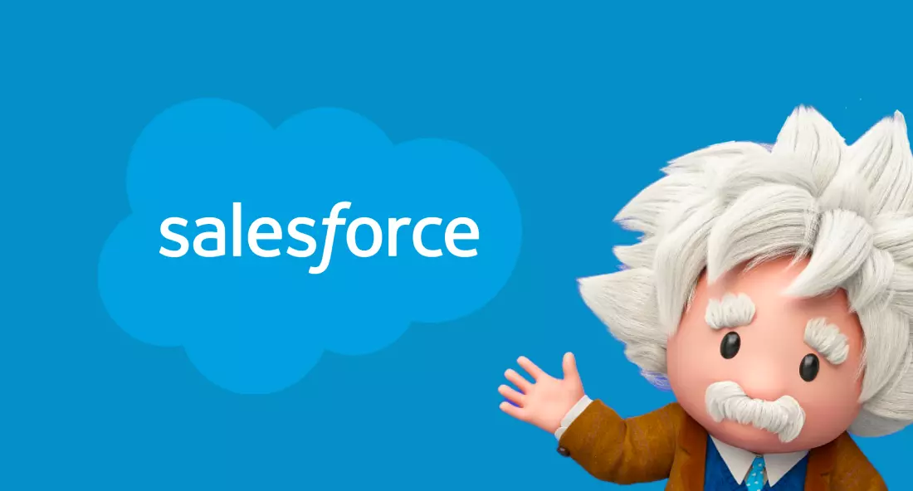
Popular AI Tools for Business Decision-Making
Power BI with AI: Power BI, Microsoft’s business analytics tool, integrates AI features that help businesses visualize data, identify patterns, and generate insights, facilitating better decision-making across departments.
Salesforce Einstein: Salesforce’s AI-powered CRM platform, Einstein, automates data analysis and provides businesses with actionable insights on customer behavior, sales forecasts, and service improvements.
AI-Driven CRM Systems: AI-powered customer relationship management (CRM) tools enhance sales and marketing efforts by analyzing customer interactions and suggesting strategies to improve engagement and retention.

Slide 13
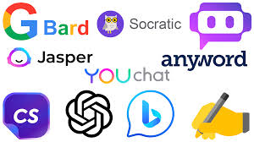
AI for Social Media
Chatbots: AI-powered chatbots engage with users in real-time, providing immediate responses to queries, offering customer support, and even processing transactions.
Sentiment Analysis: AI models analyze social media posts, comments, and reviews to determine public sentiment toward a brand, product, or service.
Automation Tools: Social media automation tools use AI to schedule posts, track engagement, and optimize content delivery.
AI tools have transformed social media engagement by automating interactions, analyzing user sentiments, and providing insights into audience behavior. These tools help businesses enhance their online presence and optimize customer interactions on platforms like Facebook, Twitter, and Instagram.

Slide 14
AI for Social Media – Potential Problems
Overreliance on Automation: Businesses that rely too heavily on chatbots may inadvertently alienate customers who prefer human interaction, especially in complex situations where emotional intelligence and understanding are needed.
Misleading Responses: If not properly designed, chatbots can offer incorrect or misleading information, potentially damaging the brand's credibility and customer trust.
Accuracy Issues of Sentiment Analysis: Sentiment analysis tools can misinterpret or oversimplify the emotions conveyed in user-generated content. They may fail to detect sarcasm, irony, or cultural context, leading to incorrect analysis and potentially misguided business strategies.
Over-saturation and Spam: Excessive use of automated posting tools can lead to content overload, causing audiences to feel bombarded by repetitive or irrelevant posts. This can harm engagement rates and lead to "unfollowing" or negative sentiment from users.

Slide 15




Best AI tools for Social Media
They can help to automate tasks, provide insights, and enhance overall social media performance, like writing captions for social media pages, graphic design, content writing, content creation and scheduling.
Lately: AI-powered social media post generator offering social media scheduling, content creation and posting, and analytics tracking.
Brandwatch: a powerful social media analytics tool that is designed to help companies understand the impact of their social media campaigns, track industry trends, and gain insights into their target audience.
Emplifi: AI-powered social media analytics and management tool for both individuals and businesses It tracks and analyzes data from various social media platforms, allowing users to see how their social media campaigns are performing in real-time. This includes reports on engagement rates, follower growth, and content performance.
Adobe Sensei: it automates repetitive tasks, such as image and video editing, analyzes data and provides insights that can help you make better marketing data-driven decisions, identifying the best time to post or suggesting new content ideas based on your audience's interests.

Slide 16
AI Tools for Content Creation
How AI Assists in Writing, Summarizing, and Creating Marketing Copy: AI tools have revolutionized content creation by automating the writing process. These tools can:
Write Articles: Generate long-form articles based on a brief or keyword input.
Summarize Content: Condense large amounts of text into succinct summaries.
Create Marketing Copy: Produce high-converting marketing content, such as ad copy, product descriptions, or social media posts, tailored to specific target audiences.
Ethical Concerns: Originality vs. AI-Generated Content One of the main ethical concerns with AI-generated content is the issue of originality. Since AI models are trained on vast datasets, they can inadvertently reproduce parts of existing content, leading to plagiarism concerns. Furthermore, the use of AI-generated content can blur the lines between human and machine authorship, raising questions about authorship, creativity, and intellectual property.

Slide 17
Best AI Tools for Content Creation
ChatGPT by OpenAI: Creates realistic and informative chatbots for various applications.
Midjourney: Generates high-resolution images based on text descriptions.
Google Gemini: Powerful AI tool for various tasks but faces competition from GPT-4. Offers different versions for different needs.
These intelligent software leverage natural language processing (NLP) algorithms and machine learning techniques to understand and respond to user input. They can analyze users’ messages, interpret the intent behind the messages, and generate appropriate human-like responses.

Slide 18


AI tools for Marketing and Sales
ManyChat: provides AI-powered chatbot solutions for marketing and sales purposes, helps businesses create interactive chatbots that automate customer interactions, lead generation, and sales processes. It can be integrated with the website, landing pages, or social media profiles to capture leads. By engaging with visitors, the chatbot can collect contact information and qualify leads based on predefined criteria.
These tools can be applied in different sectors in marketing such as generating videos for ads, presentations, product descriptions and reviews, and any other content for marketing purposes. They help sales teams manage customer interactions, track leads, and streamline the sales process. They analyze customer data, provide personalized recommendations, and automate tasks like lead scoring and email campaigns.
Brand24: helps businesses track mentions of their brand, products, or competitors on social media. It utilizes advanced algorithms and machine learning techniques to analyze social media data by sentiment analysis, trend detection, and influencer identification.

Slide 19
Best AI tools for Marketing and Sales
Personalization: AI-Powered Recommendation Engines
AI-driven recommendation engines analyze user behavior, preferences, and past interactions to suggest relevant products or services.
Example: Netflix and Amazon use AI to personalize content and product recommendations, increasing engagement and sales.
Benefits: Improved customer retention, higher conversion rates, and enhanced user satisfaction.
Tools example:
Azure.ai understands textual data through sentiment analysis, entity recognition, keyphrase extraction, language detection, and text classification, helping to analyze customer feedback, social media mentions, or survey responses to gain insights into customer sentiments and preferences. It offers chatbots and virtual assistant services that enable the development of intelligent chatbots and virtual assistants.

Slide 20
Best AI tools for Marketing and Sales
CRM and Automation: Salesforce Einstein, HubSpot AI
AI-powered CRM systems like Salesforce Einstein and HubSpot AI enhance customer interactions by automating data analysis, lead scoring, and personalized messaging.
AI predicts customer behavior, identifies potential sales opportunities, and streamlines communication.
Risks: Over-reliance on AI could reduce the human touch in customer interactions, potentially harming long-term relationships.
Tools example: Salesforce Einstein analyzes customer data, including demographics, browsing behavior, and engagement history, to score and qualify leads. It identifies the most promising leads, helping to anticipate customer behavior, identify opportunities, and make data-driven decisions for campaign optimization.

Slide 21
Best AI tools for Marketing and Sales
AI-Generated Ad Creatives (e.g., Meta Advantage+)
AI tools like Meta Advantage+ and Google Performance Max optimize ad creatives by automatically generating and testing different ad variations to maximize engagement.
AI analyzes audience responses in real time to refine messaging and visuals for better performance.
Ethical concern: Over-automation may lead to generic, impersonal ad experiences and reliance on AI-generated content without human oversight.
Tools example:
Meta Advantage+ leverages AI to automate and optimize ad campaigns by analyzing audience behavior, engagement patterns, and conversion data. It dynamically adjusts targeting, creative assets, and budget allocation in real-time to maximize ad performance. By identifying high-performing audience segments and predicting which ads will generate the best results, Meta Advantage+ helps businesses improve return on investment (ROI) and streamline digital marketing efforts.

Slide 22
Decision Framework for Choosing AI Tools
Selecting the right AI tool for a business requires careful consideration of multiple factors, balancing functionality, cost, and integration capabilities.
Factors to Consider:
Business Needs: Define clear objectives—e.g., improving efficiency, automating workflows, or enhancing customer experience.
Scalability: Ensure the AI tool can grow with the business and handle increasing data loads.
Ease of Integration: The AI tool should be compatible with existing software and infrastructure.
Cost vs. ROI: Consider the financial investment versus the expected return. Some AI tools require significant upfront costs but offer long-term efficiency gains.

Slide 23


AI in Trading and Finance
An AI-driven automated trading platform is a software system that utilizes artificial intelligence and machine learning techniques to make automated trading decisions in financial markets. These platforms are designed to analyze vast amounts of market data, identify trading opportunities, and execute trades without human intervention.
Examples of Popular tools:
Tickeron: provides traders with advanced tools and technology to enhance their investment strategies. It scans charts and identify various chart patterns, such as triangles, double tops, provides pattern recognition technology, automated trading robots.
TrendSpider: employs automated technical analysis with powerful scanning capabilities that can identify and draw trendlines, support and resistance levels, chart patterns, and Fibonacci retracements automatically, which saves traders significant time and effort, and enables them to focus on high-level decision-making rather than manual chart analysis.
.

Slide 24

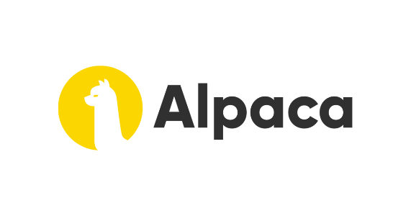
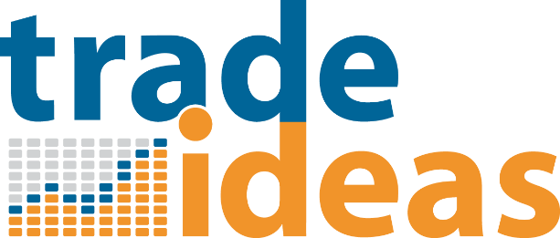

AI-Driven Trading Platforms Examples
Kavout – Uses machine learning to analyze financial data and rank stocks based on predictive signals.
Alpaca – AI-powered commission-free trading API for algorithmic trading.
Trade Ideas – AI-driven stock market analysis tool that identifies trading opportunities based on historical patterns.
TuringTrader – Uses AI for quantitative investment strategies and automated portfolio management.

Slide 25


AI Robo-advisors in Trading and Finance
Automated Portfolio Optimization – AI constructs and rebalances diversified portfolios using Modern Portfolio Theory (MPT) to maximize returns while managing risk.
Tax-Loss Harvesting – Machine learning models identify opportunities to sell assets at a loss to offset taxable gains, improving after-tax returns.
Cash Flow & Withdrawal Optimization – AI-driven strategies manage cash reserves, automate withdrawals, and optimize tax efficiency in distributions.
Customizable Investment Strategies – AI applies factor-based investing and ESG screening, enabling investors to align portfolios with financial and ethical preferences.
Examples: Wealthfront and Betterment use AI to manage investment portfolios based on user-defined goals.

Slide 26


Predictive Analytics for Market Trends
AI uses historical financial data to forecast market movements, helping traders and investors make informed decisions. AI models analyze news sentiment, economic indicators, and stock price patterns to predict trends.
Limitations: AI’s accuracy depends on the quality of data, and unforeseen economic events can disrupt predictions.
Risks: Sudden market fluctuations can cause AI-driven trading systems to make rapid, ill-informed decisions, increasing volatility.
Examples: Sentieo provides predictive analytics and sentiment analysis from news, filings, and reports. Numerai crowdsources AI models to predict stock market trends.

Slide 27
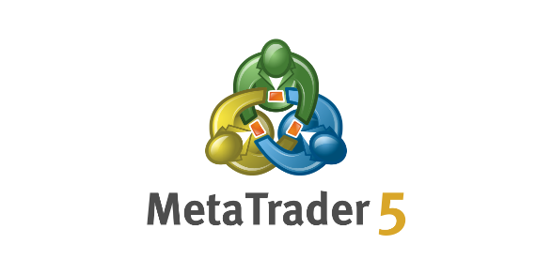


Algorithmic Trading APIs & AI Assistants
MetaTrader 5 (MT5 AI Plugins) – AI-powered trading bots for automated forex and stock trading.
IBM Watson for Financial Services – AI assistant for compliance, risk analysis, and portfolio optimization.
H2O.ai – Open-source AI platform used for financial modeling, fraud detection, and credit scoring.

Slide 28


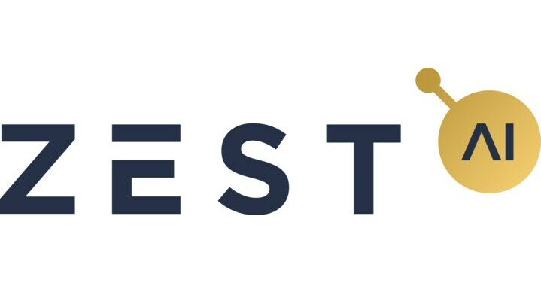
AI-driven Fraud Detection & Compliance Tools
Darktrace – AI-powered cybersecurity for financial fraud detection and risk mitigation.
FICO Falcon Fraud Manager – AI tool for real-time fraud detection in banking transactions.
Zest AI – Uses AI to assess credit risk and enhance lending decisions.

Slide 29
Risks and Limitations of AI in Financial Decision-Making:
Data Bias: AI models trained on biased historical data may reinforce inequalities in credit scoring and loan approvals.
Lack of Transparency: Many AI-driven financial models function as “black boxes,” making it difficult to explain decisions.
Regulatory Challenges: Financial institutions must navigate strict regulations to ensure AI systems comply with risk management and consumer protection laws.

Slide 30
Decision Framework for Choosing AI Tools
Step 1: Identify the business problem AI should solve.
1
Step 2: Evaluate available AI tools based on accuracy, efficiency, and compatibility.
2
Step 3: Conduct pilot tests to measure effectiveness before full deployment.
3

Slide 31
Integrating AI into Business Processes
Successful AI adoption requires seamless integration into existing business workflows, ensuring compatibility with databases, cloud platforms, and enterprise systems.
AI and Cloud Platforms (AWS, Azure, Google Cloud)
AI tools often rely on cloud computing to handle vast amounts of data and processing power.
Example: AWS AI Services (Amazon SageMaker), Microsoft Azure AI, and Google Cloud AI offer ready-to-use AI solutions for businesses.
Cloud-based AI reduces infrastructure costs and allows businesses to scale AI capabilities without heavy investments in hardware.

Slide 32
Integrating AI into Business Processes
How AI Connects with Databases and Enterprise Systems
AI models require seamless access to structured and unstructured data stored in company databases.
APIs and middleware enable AI tools to integrate with existing software like ERPs (Enterprise Resource Planning) and CRMs.
Example: AI-powered chatbots integrated into customer support systems provide automated assistance based on real-time data retrieval.

Slide 33
Integrating AI into Business Processes
Challenges of AI Integration: Data Quality & Compatibility
Data Quality Issues: AI performance depends on high-quality, clean data. Inconsistent or biased data can lead to inaccurate outputs.
Compatibility with Legacy Systems: Many businesses struggle to integrate AI with older IT systems, requiring costly upgrades.
Security and Compliance: AI implementation must adhere to industry regulations regarding data privacy and cybersecurity.

Slide 34
Best AI Virtual Assistants
Virtual assistants are becoming increasingly popular as they provide convenient support to get things done both for individuals and in business, enabling users to engage in natural language conversations and perform various tasks through voice or text inputs.
Apple Siri: can perform various tasks, including sending emails, checking the weather, providing navigation guidance, setting alarms, and even controlling smart home devices.
Google Assistant: capable of performing an extensive range of tasks. It excels in voice recognition, understanding natural language queries, and providing relevant responses to send messages, make phone calls, set reminders, manage calendars, play music, and control smart home devices.
Amazon Alexa: allows users to engage in conversations with the assistant, asking questions, giving commands, and even engaging in natural back-and-forth interactions.

Slide 35
Best AI-driven Search Engines
Bing: uses AI features to provide more personalized results, together with a conversational experience, resulting in more comprehensive and informative search results.
YouChat: an AI chatbot to search the web, it uses natural language rocessing to understand your queries and provide relevant answers. It can answer complex questions, explain concepts, suggest ideas, translate texts, summarize articles, compose emails, and write code snippets.
Perplexity: uses a chatbot-like interface that allows users to ask questions in natural language. Its AI's responses are grounded in providing accurate and relevant information through citations, which makes users confident that the information they are getting is relevant and correct.
Unlike traditional search engines which use algorithms based on factors like keywords, popularity, and backlinks to rank search results, AI-powered search engine use AI to enhance the search experience and deliver more accurate and relevant search results.

Slide 36


Additional AI Tools for Experts
Hugging Face: A platform for AI experts and data scientists to develop sophisticated AI models for Natural Language Processing (NLP) tasks.
Claude AI: Offers superior performance and fluency in complex tasks. Can handle a large context window and summarize long documents.
Trained on large datasets of conversations these tools can use techniques such as deep learning to generate more contextually relevant and accurate responses.

Slide 37
AI in Finance (Fraud Detection)
How AI Detects Fraud:
Machine learning models analyze vast amounts of transaction data to identify patterns associated with fraudulent activity.
Anomaly detection algorithms flag unusual transactions based on deviations from a customer’s typical behavior.
Real-time monitoring enables financial institutions to act immediately when a suspicious transaction is detected.
Tools example: Mastercard Decision Intelligence – AI-powered fraud detection system.
FICO Falcon Fraud Manager – Uses neural networks to score transactions in real time.
IBM Safer Payments – AI-driven risk assessment for financial institutions.

Slide 38

Case Study: JPMorgan Chase – AI-Powered Fraud Detection
JPMorgan Chase, one of the largest financial institutions in the world, deals with millions of daily transactions. Detecting fraudulent activities manually was inefficient and prone to errors, leading the bank to implement AI-driven fraud detection. Read the article: https://medium.com/@jeyadev_needhi/how-ai-transformed-financial-fraud-detection-a-case-study-of-jp-morgan-chase-f92bbb0707bb

Slide 39
Case Study: JPMorgan Chase – AI-Powered Fraud Detection
AI Implementation:
JPMorgan Chase deployed machine learning algorithms to analyze transaction patterns and detect anomalies in real time.
Their system uses deep learning models to recognize fraudulent activities by evaluating transaction history, device information, and behavioral patterns.
AI enhances risk scoring, allowing the bank to block suspicious transactions before they are completed.
Results & Impact:
Significant reduction in fraud losses, saving millions of dollars annually.
Faster fraud detection – AI analyzes transactions within milliseconds.
Improved customer experience – fewer false positives, reducing unnecessary transaction blocks for legitimate users.

Slide 40
Case Study – AI in Finance (Fraud Detection)
Benefits of AI in Fraud Detection:
Faster fraud detection – AI systems analyze thousands of transactions per second, providing instant alerts.
Reduced financial loss – Early detection prevents fraudulent transactions from being processed.
Improved accuracy – AI reduces false positives, minimizing disruptions for legitimate customers.
Real-time monitoring enhances security without slowing down transactions.

Slide 41
AI Risks & Ethical Concerns
Bias in AI Models
AI models can inherit biases from training data, leading to unfair outcomes.
Example: Discriminatory credit scoring where AI denies loans to certain demographics due to biased historical data.
Data Privacy Concerns
AI-driven surveillance and tracking raise privacy issues, as seen in facial recognition technology.
Companies must ensure compliance with regulations such as GDPR to protect user data.
Transparency and Explainability Issues
Many AI systems operate as “black boxes,” making it difficult to understand how decisions are made.
Example: AI-driven hiring tools rejecting candidates without clear explanations.
The need for explainable AI (XAI) to improve accountability.
Other Risks:
Job displacement – AI automation replacing human roles.
Security vulnerabilities – AI models susceptible to adversarial attacks.

Slide 42
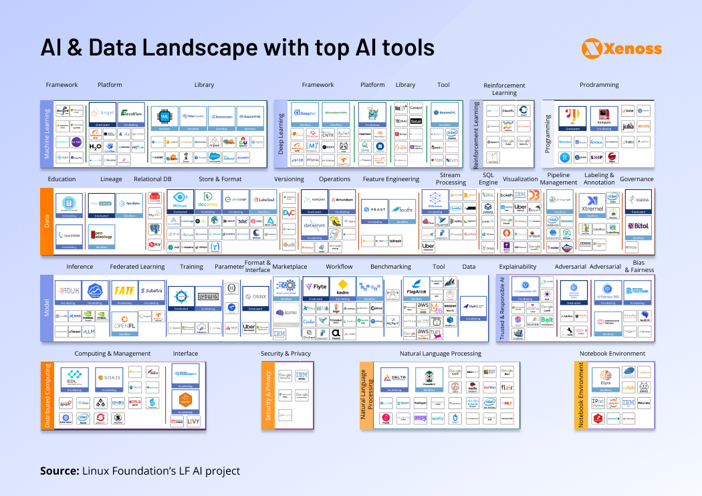
AI tools are changing every day!

Slide 43
Future Trends in AI Tools & Platforms
Emerging AI Trends:
Generative AI – AI models like ChatGPT, DALL·E, and Sora generating realistic text, images, and videos.
Multimodal AI – AI systems capable of processing and integrating multiple types of data (text, images, speech) for more sophisticated applications.
Real-time AI – Faster processing and decision-making with AI integrated into real-time applications (e.g., financial trading, autonomous vehicles).
AI Regulation and Governance:
Growing efforts to regulate AI, such as the EU AI Act, focusing on transparency, fairness, and accountability.
Ethical AI frameworks ensuring responsible AI deployment in business.
AI’s Role in Business Strategy:
Increased AI adoption across industries, optimizing operations and decision-making.
Shift from AI as a tool to AI as a strategic business driver, influencing innovation and competitive advantage.

Slide 44
Summary & Key Takeaways
Key Takeaways:
AI tools enhance efficiency, automate tasks, and provide data-driven insights.
Business applications include marketing, finance, customer service, and fraud detection.
Ethical concerns such as bias, transparency, and privacy must be addressed.
Future trends point to more advanced AI models, regulatory frameworks, and AI-driven business strategies.

Slide 45
Summary & Key Takeaways
Final Thoughts:
AI is no longer just a technological innovation; it is a fundamental component of modern business. However, ethical considerations, strategic implementation, and continuous oversight are essential for responsible AI adoption.
Thank you!

